Slide 1

Today’s Cities and Suburbs
By Shane Cincotta

Slide 2
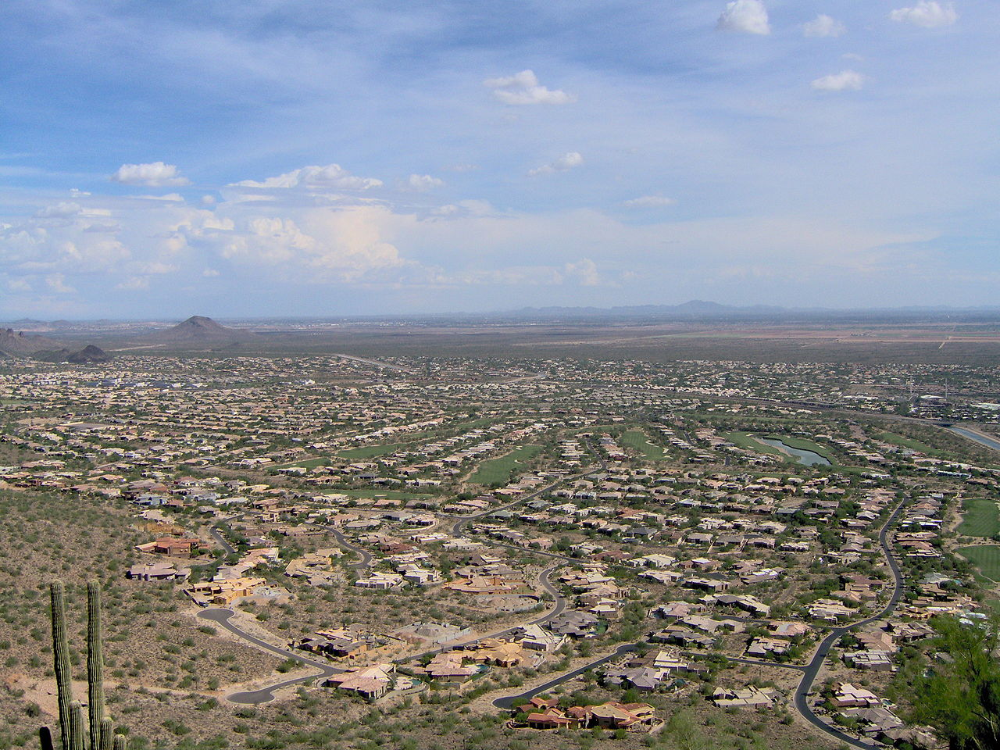
The Phenomenon of Sprawl
Migration of people into low-density developments
The result of unplanned, rapid growth and poor land-use management.
Suburbanization
Growth vs sprawl
Sprawl in Phoenix metropolitan area

Slide 3
Why Do We Have Sprawl?
Political Fragmentation
Local governments negotiate land use separately
Achieving The American Dream
People have a feeling they “made it”
Government policies have subsidized low-density development
Cheaper to develop land in low-density zones vs the downtown area

Slide 4
Consequences of Sprawl
Environmental Damage
Disruption of wildlife habitats
Toxic runoff
Destruction of wetlands
Traffic Problems
Longer commutes
Greater traffic congestion
More Greenhouse gases
Financial Costs
Costs of delivering services increases
Weakens downtown commerce
Erodes tax base

Slide 5
What Is Smart Growth?
Smart growth is the alternative to sprawl
Involves comprehensive land-use planning
Environmentally sensitive
Transit/pedestrian oriented
Has a mixed use of lands
Mix of commercial, residential and retail space
Social Impact Analysis
Interdisciplinary effort to determine the likely consequences of a project before its construction.

Slide 6
Modes of Smart Growth
Urban Growth Boundaries
Official boundary to contain urban areas
E.G Portland Oregon in 1975
Revitalizing existing towns and cities
Restoring architecture
Relocation of corporate giants
Eminent domain
Transit oriented approaches
More highway lanes with carpool lanes
Rail lines along highways to connect cities and suburbs
Greening our cities
Replace diesel fuel buses with hybrids
Improve cycling/walking infrastructure
Green roofs

Slide 7
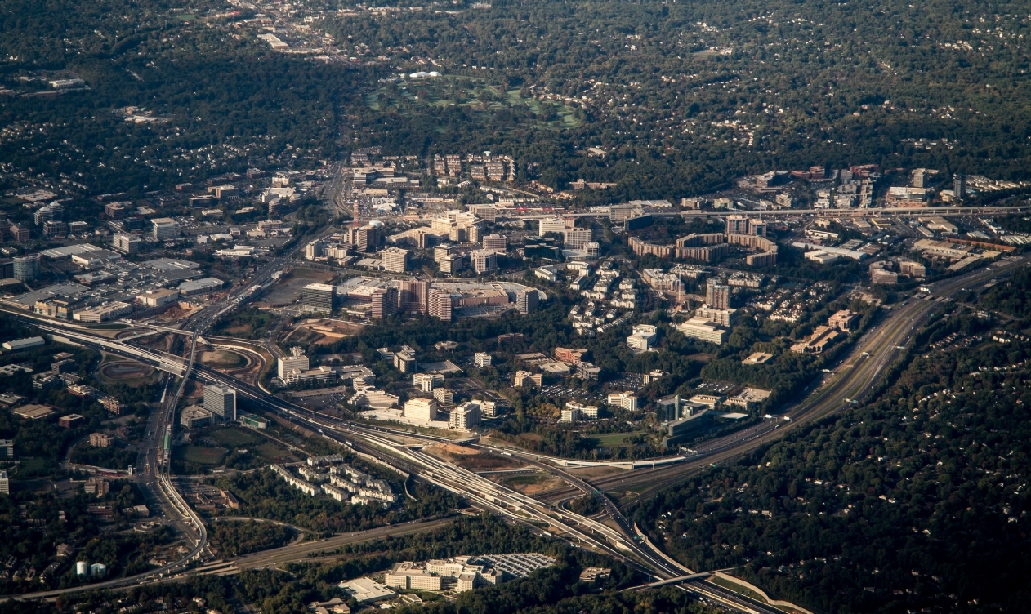
The New Cities
Edge Cities
Sprawling, middle-class, centers that typically located at the fringe of an older urban area
Emerged at the intersection of major highways
Used to be villages or farmland
Usually centered around shopping malls
Tysons Corner, Virginia

Slide 8
New vs Old Cities
New Cities
Old Cities
More spread out
Exist in locations which were once rural not long ago
Jointly shared security patrol
Shopping malls are anchor points
Compact
Clearly defined territorial boundary
Political organization/elected officials
Extensive office/retail space
Influx of workers weekday mornings
Work, shopping and entertainment zones

Slide 9
Types of New Cities
Uptowns
Built on top of pre-automobile settlements, such as Pasadena, California
Boomers
New city located at the intersection of two major highways and almost always centered on a mall.
Strip Boomer City
Fairly narrow and extends along a major high- way for several miles, such as along Route 128 near the Mass Pike
Node Boomer City
More contained and dense, such as Tysons Corner in Virginia
Pig-In-Python Boomer City
Combination of the other two in that it occurs along a highway strip with several nodes, such as the Lodge Freeway in the Southfield area
Greenfields
Master-planned city by one developer on thousands of farmland acres
such as Irvine, California

Slide 10
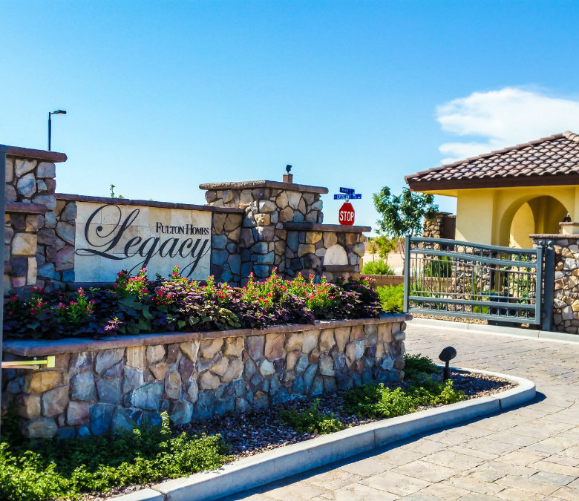
Gated Communities
First gated community was built in 1853 at Llewellyn Park in West Orange, New Jersey.
Defended by walls
Electronic Gates
Patrolled by private security forces
Reminiscent of radio-centric cities
Pay-as-you-go services
Share responsibility for common areas, rules and regulations
Lack of elected officials

Slide 11
Types of Gated Communities
Lifestyle communities
Emphasize amenities and include retirement communities
Attract those who want separate, private services within a homogeneous environment.
Prestige communities
Status-oriented enclaves
Attract those seeking a stable neighborhood of similar people where property values will be protected
Security zone communities
“Enclaves of fear”
They are a defensive measure reflecting a fortress mentality
Their primary goal is to exclude those people their residents perceive as threats

Slide 12
Consequences of Living In a Gated Community
Living in segregated and isolated enclaves diminishes social life.
Lacks the feeling of community
All residents can do is compare their own material gains with those of their neighbors
Keeping up with the Joneses
Effectively limit social contact among different members and groups of society.
De facto segregation

Slide 13
Common Interest Developments
A common interest development is similar, but not the same, as a gated community
CID require membership in a self-governing homeowners’ association
Buyers are willing to accept smaller lots and narrower streets, because the development contains facilities owned by all residents
Swimming pools, gyms, parks, golf courses, social centers, and often even exclusive access to shopping centers and their own schools.
Residents surrender much of their freedom and privacy
Residents live under the rule of an elected group of neighbors enforcing a set of restrictions created by the developer

Slide 14
Work Cited
Sprawl In Phoenix Metropolitan Area
Tysons Corner, Virginia
Gated Community

